Slide 1
AREC 570 Slides

Slide 2
Unit 1
Foundations of Economic Research

Slide 3
Introduction
Greenlaw Ch 1; Ethridge Ch 2

Slide 4
Introduction
What is economic research?
What is the goal of economic research?
How do we do economic research?
How do we evaluate economic research?
Why should we study economic research methodology?

Slide 5
What is economic research?
“research is the systematic approach to obtaining new and reliable knowledge… the process by which we discover, evaluate, and confirm the stock of economic knowledge.” - Ethridge Ch 2
Farmer vs detective metaphor - knowledge is created through argument
Journals are the forum for discussion. “Through this dialog, arguments are evaluated, the weaker ones are winnowed out, and the stronger ones are refined and improved” (we will return to this in McCloskey)

Slide 6
Minimum wage example
Those doing economic research observe and theorize about the laws governing employment in a market economy.
From that theory comes a prediction that, ceteris peribus, an increase in the minimum wage above the equilibrium will result in lower employment.
This theory can then be evaluated by empirical study.
We either confirm or reject the theory and possibly revise theory.

Slide 7
Ethridge: What research is and isn’t
Research is the systematic approach to obtaining and confirming new and reliable knowledge
Research is:
Searching for explanations
A process
Research is not:
Accidental discovery
Data collection (though it is a critical part of research)
Searching out published research (though literature review is important part of the research process)

Slide 8
Basic and applied research
Basic: proposing new theories or methods and investigating their properties. Ex: new functional forms, new estimators. Audience is other economists/researchers
Fundamental economic research is still about human behavior
Disciplinary research
Applied: applying theories or tools to study real world problems.
Subject-matter: climate change
Problem solving: cap and trade in CA policy analysis
Both and interdependent and influence each other. How?

Slide 9
What is the goal of economic research?
To learn or better understand economic processes, relationships between people/firms in society, relationships between people and natural resources
Doing the research frequently requires solving problems… solving a model or doing econometrics, but this is not the goal of the research
Throughout the research process ask yourself
“Is what I am doing helping me achieve the goal of research”

Slide 10
How do we do economic research?
Apply methods to solve identified economic research questions
Identify questions → develop hypothesis (based on theory) → collect and analyze data → revise theory → repeat
Research does not proceed linearly or as easily as it may sound when reading a journal article. Often fits and starts with many dead ends.
Any examples?
Collaboration: Economics is inherently multidisciplinary. Economics deals with human activities that are affected by social religious political governmental institutional physical by and biological factors.

Slide 11
Research Process
Identify problem and develop research question
Formulate objectives
Plan and design research methods
Do project and generate results
Interpret and draw conclusions
Communicate your research to audience
Sub-discipline, discipline, academic, practitioners, general audience

Slide 12
Creativity
Prescriptive: creativity in converting research into policy
Transferable quota in commercial fishing
Applied: creativity in finding appropriate solution concepts to problems
Nash equilibrium to the location choice
Theoretical: drawing connections between abstract concepts
Fire and moral hazard
How can you cultivate creativity?

Slide 13
How do we evaluate economic research?
Evaluate an argument by thinking critically about the component parts: assumptions, logic, evidence
Is the logic flawed? This is usually handled by the model and logic is imposed by mathematics. Move toward empirics is making this less clear in papers
Are the assumptions necessary to draw the conclusions? Would changing the assumptions lead to different conclusions. Recognize implicit assumptions and try to make them explicit
Does the evidence support the conclusion?
Is the argument persuasive?

Slide 14
Why should we study economic research methodology?
Understanding the process by which we conduct research is the most efficient way to produce new knowledge
Methods vs. methodology
Methods are the specific details about how a problem is solved
  The other courses you will take cover methods of economics
Methodology provides the principles for organizing, planning, designing, and conducting research.
  The science and art of research
  Goal is to expand and confirm body of knowledge. Research methodology is the study of how we accomplish that goal.

Slide 15
Poppers Philosophy of Science
Evaluating logic
Modes of argument
Validity
Soundness
Forms of reasoning
Scientific Theory

Slide 16
Two modes of argument from philosophy
Modus ponens (mode that affirms): the rule of logic stating that if a conditional statement (“if p then q ”) is accepted, and the antecedent ( p ) holds, then the consequent ( q ) may be inferred.
Ex: If Socrates is a man then Socrates is mortal. Socrates is a man. Therefore, Socrates is mortal.
At one point, most research progressed in this way… and most people think that it does today.
Modus tollens (mode that denies): if p then q. The consequent (q) does not hold, therefore the antecedent (p) must not be true.
If Socrates is a god, then Socrates is immortal. Socrates is not immortal. Therefore, Socrates is not a god.
Popper’s philosophy proposes that we use modus tollens to carve away at untruths to hopefully leave truth remaining.

Slide 17
Examples
If Jane has a cat, then Jane has a pet.
Jane has a cat.
Therefore, Jane has a pet.
If Jane has a cat, then Jane has a pet.
Jane does not have a cat.
Therefore, Jane does not have a pet.
If utility is maximized subject to a budget constraint, then an individual is as happy as possible.
An individual is as happy as possible.
Therefore, utility must be maximized subject to a budget constraint.
If price equates supply and demand, the market is efficient.
The market is not efficient.
Therefore, price does not equate supply and demand.
If a market exists for a private good with complete information, the equilibrium is efficient.
A market exists for a good with complete information.
Therefore, the equilibrium is efficient.

Slide 18
Examples
If Jane has a cat, then Jane has a pet. (MP: Modus Ponens. The condition happened, so the consequence must happen.)
Jane has a cat.
Therefore, Jane has a pet.
If Jane has a cat, then Jane has a pet. (X DA: Denying the Antecedent. No cat -> no pet doesn’t logically follow.)
Jane does not have a cat.
Therefore, Jane does not have a pet.
If utility is maximized subject to a budget constraint, then an individual is as happy as possible.
An individual is as happy as possible.
Therefore, utility must be maximized subject to a budget constraint. (X AC: Affirming the Consequent. Invalid reasoning)
If price equates supply and demand, the market is efficient. (MT: Modus Tollens)
The market is not efficient.
Therefore, price does not equate supply and demand.
If a market exists for a private good with complete information, the equilibrium is efficient. (X Invalid MP)
A market exists for a good with complete information.
Therefore, the equilibrium is efficient.

Slide 19
Validity
An argument is valid if it is impossible for premise to be true while conclusion is false (regardless of whether the premises are true)
The argument is internally consistent
An argument here is the set of statements
Valid
All men are mortal.
Socrates is a man.
Therefore, Socrates is mortal.
Invalid
All men are immortal.
Socrates is a man.
Therefore, Socrates is mortal.

Slide 20
Soundness
An argument is sound if it is valid and the premises are true
Sound
All men are mortal.
Socrates is a man.
Therefore, Socrates is mortal.
Unsound
All birds can fly.
Penguins are birds.
Therefore, penguins can fly.

Slide 21
Inductive and Deductive Reasoning
Deductive reasoning: a series of assumptions and relationships (a general or universal statement and a specific or singular statement) lead to certain expected outcomes.
  Deductive reasoning, or deduction, starts out with a general statement, or hypothesis, and examines the possibilities to reach a specific, logical conclusion.
  Example: Equilibrium price is a deduced outcome of assumptions about market structure and motivation of producers and consumers.
  Deductive reasoning relies on the validity of the argument.
  Conclusions can be proven but the premises themselves are taken as given and may not be provable.
Inductive reasoning: extending a specific circumstance or outcome to a general conclusion.
  E.g., Statistical inference: taking a result based on a sample and extending it to the population.
  "The coin I pulled from the bag is a penny. That coin is a penny. A third coin from the bag is a penny. Therefore, all the coins in the bag are pennies."

Slide 22
What type of reasoning is used?
No mayten tree is deciduous, and all nondeciduous trees are evergreens. It follows that all mayten trees are evergreens.
Mike must belong to the Bartenders and Beverage Union Local 165, since almost every Las Vegas bartender does.
Either Colonel Mustard or Reverend Green killed Professor Plum. But whoever ran off with Mrs. White did not kill the professor. Since Reverend Green ran off with Mrs. White, Colonel Mustard killed Professor Plum.
Since some grapes are purple, and all grapes are fruit, some fruit is purple.

Slide 23
What type of reasoning is used?
No mayten tree is deciduous, and all nondeciduous trees are evergreens. It follows that all mayten trees are evergreens. D
Mike must belong to the Bartenders and Beverage Union Local 165, since almost every Las Vegas bartender does. I
Either Colonel Mustard or Reverend Green killed Professor Plum. But whoever ran off with Mrs. White did not kill the professor. Since Reverend Green ran off with Mrs. White, Colonel Mustard killed Professor Plum. D
Since some grapes are purple, and all grapes are fruit, some fruit is purple. I

Slide 24
Anyone want to share their examples of MP and MT from their research experience?
Did talking through it today help you understand or think of different ideas?

Slide 25
Popper continued
Ingredients of a theory
4 Criteria to judge scientific theories
Internally valid
Testable
Popper’s chopper (falsifiable)
Withstand repeated empirical testing

Slide 26
Employment falls because of an increase in the min wage
People are rational
People have complete information
People want to earn more money in order to satisfy other wants
Firms want to hire at lowest wage rate
A wage above the equilibrium creates a labor shortage
Min wage blocks the system from tending toward equilibrium

Slide 27
Internal Validity
Theory consists of a set of foundational axioms (independent, free of contradiction) from which statements or logical conclusions may be deduced (hypotheses and predictions).
Our theory of the consumer is axiomatic. The statements provide the foundation for theory of demand. They are logically consistent and other statements can be deduced i.e., demand is downward sloping.
Examples: completeness (able to compare all bundles), transitivity, complete information, utility and profit maximization

Slide 28
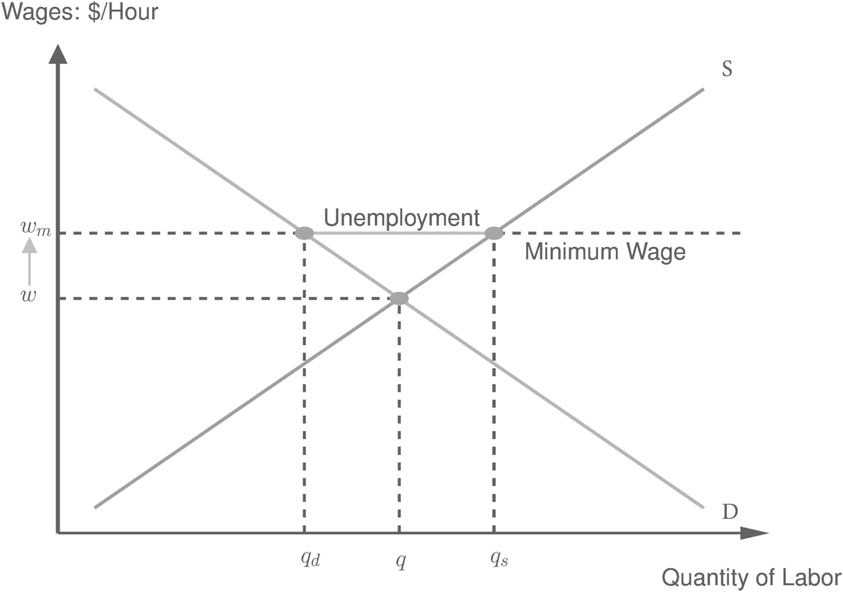
Min wage: Validity?
Consumer theory - labor supply
Production theory - labor demand

Slide 29
Testable
“Secondly, there is the investigation of the logical form of the theory, with the objective of determining whether it has the character of an empirical or scientific theory, or whether it is, for example, tautological”
3 requirements:
It must be a possible world
Demarcation, measurable, able to experience. Not metaphysical.
Must be distinguishable as our world that we live in.

Slide 30
Min wage: testable?
We can observe wages and employment as well as the implementation of policy

Slide 31
Popper’s chopper (Occam’s razor)
A theory that provides a more simple explanation (with fewer assumptions) is better
Why is popper so concerned with this?
Because the simple theory is easier to falsify.
The experiment necessary to falsify requires fewer assumptions to be met.

Slide 32
Min wage: simple?
Are there alternative explanations (theories) of how the min wage would impact employment?
If so, do they provide a simpler explanation of the effect?

Slide 33
Withstand repeated empirical test
The theory must survive repeated tests based on data collected from the world we experience.
We must subject the minimum wage hypothesis to repeated empirical scrutiny.
This can be particularly challenging in a discipline focused on human behavior where human behavior is often mediated through culture that may change over time. In other words, the world we experience may itself be changing requiring us to modify theory over time.

Slide 34
Min wage: withstand repeated testing?
Min wage has seen a renewed attention.
More empirical research finds little or no effect now.

Slide 35
Min wage example
Hypothesis: Assume simple (101) labor model, then minimum wage reduces employment relative to no policy case.
Prediction: If hypothesis is true, employment in Seattle should fall when minimum wage increased to $15/hr.
Test: We can empirically evaluate whether employment falls in response to minimum wage increase.
Use modus tollens: employment does not decline; therefore, hypothesis is not true. Hypothesis is not true; therefore, axioms are not true.
https://www.cato.org/policy-analysis/making-sense-minimum-wage-roadmap-navigating-recent-research#research-on-the-long-history-of-u-s-minimum-wage-changes

Slide 36
Concluding thoughts
Popper claims we must describe the rules of the method of science. What he means is a description of the context in which "science" occurs.
Science is without end
The stock of knowledge evolves over time
This systematic approach to science has two important implications:
No theory can be conclusively proven.
No theory can conclusively be disproven.
Modus ponens relies on the validity of the premise which cannot be proven or disproven.
Modus tollens does not test the theory directly – you cannot conclusively rule out other explanations.

Slide 37
Popper’s critics
Falsification criteria is too strict. Evolutionary bio cannot be falsified
Deduction and testing is too idealized. Science uses induction, abduction, analogy, intuition.
Popper’s view of science is too simplistic and does not account for historical, social, and cultural factors that influence science

Slide 38
McCloskey - How Economists Persuade

Slide 39
Overview
Communication matters
Science is conducted in a social context - audience matters
Metaphor
Narrative Form
Communication in economics

Slide 40
Science in a social context
“Science, is human persuasion, not mechanical demonstration”
We are communicating our research with others and we should be cognizant that we are persuading them.
Audience matters… Reagan tax rate and revenue example.
Rhetoric is important. What is rhetoric?

Slide 41
Metaphor
Claims an economic model is a metaphor. What does McCloskey means?
Any examples?
One chooses a metaphor to steer other’s minds toward a specific element or prediction and probably away from others. You strategically choose a metaphor to persuade.
What metaphor is Akerloff (1970) associated with?
Notes:
Invisible hand

Slide 42
Blub blub effect and non-econ audience
Academic econ journal articles encourage vocabulary that is increasingly hard for non-economists to understand.
Nicholas quote
Uses this quote to “undermine the neoclassical measure of productivity change”
Is economics better off writing to itself or making its ideas available to others?

Slide 43
Narrative Form
Science has a tradition of third person narrative form. Why?
Third person narrative conveys an objectivity. I am not arguing this point; it is evident from the data/statistical results.
First person narrative is direct, is usually easier to understand, and can usually be written with fewer words. Scientific writing is moving toward first person narrative.

Slide 44
McCloskey vs P-values
What is McCloskey’s argument?
Blind faith in statistical significance is not alone helpful
Is the finding of economic significance?
What are the consequences of the error?
Type 1 (mistakenly reject true null) vs. Type 2 error (fail to reject false null)
Is it better to convict an innocent person (t1) or acquit a guilty person (t2)?
How we trade off types of error is worthy of attention.

Slide 45
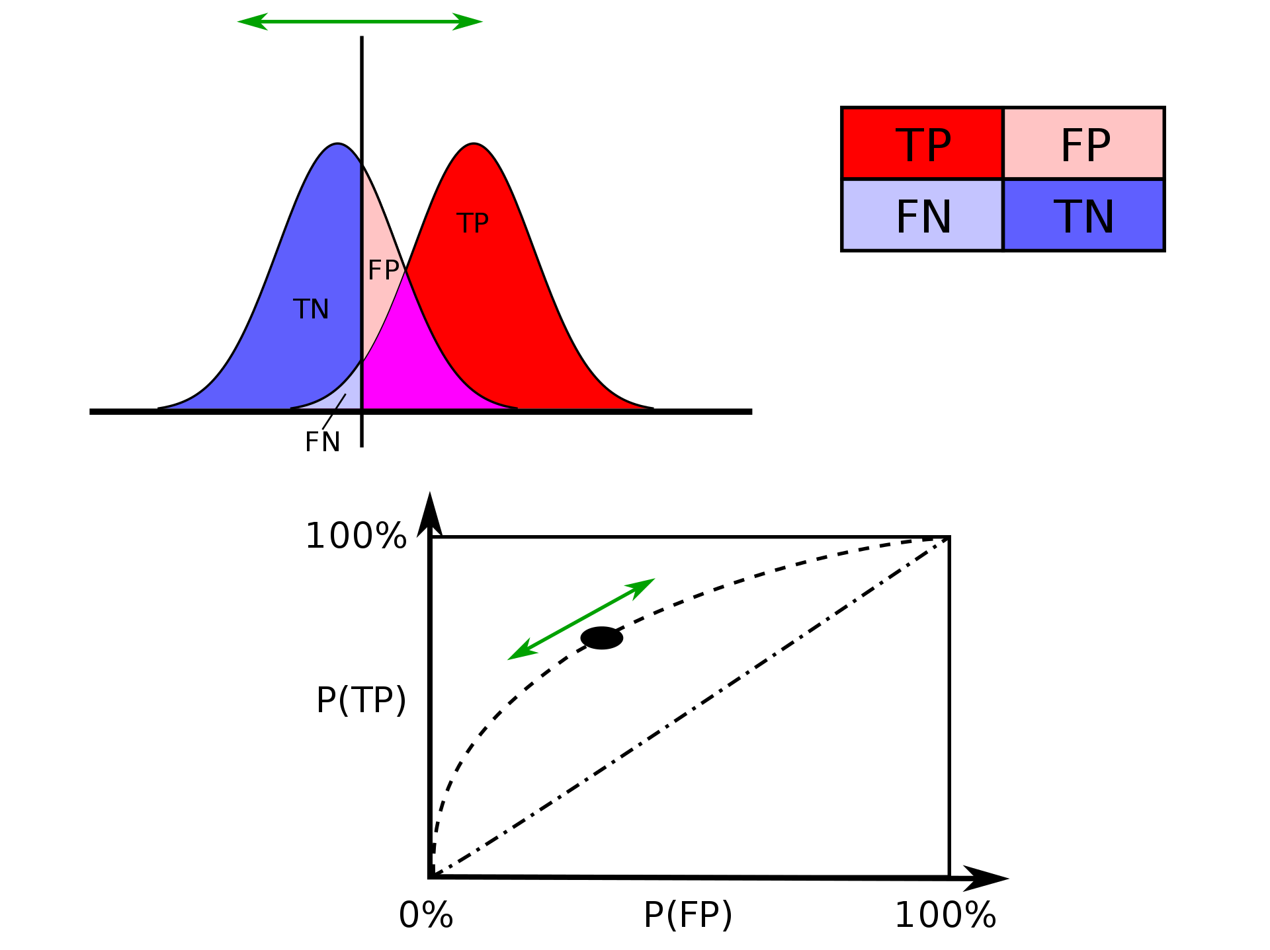

Slide 46
Language and communication in economics
What role does language play in econ?
Information
Direction
Persuasion
Many jobs depend on ones ability to persuade
Sales
Understanding bureaucracy

Slide 47
How economists persuade
Economics should recognize the importance of talk and persuasion
It plays an important role in the decisions of the agents we study
Econ has evolved to communicate via math and empirical evidence

Slide 48
Ethridge Chapter 3

Slide 49
Overview
Types of knowledge
Logic and reasoning
Tests for reliability
Scientific prediction

Slide 50
Science as systematic inquiry
the organized accumulation of systematic reliable knowledge for the purpose of intelligent explanation or prediction
How does Ethridge describe explanation and prediction as intertwined terms?
Science does not consist of facts or truths. Everything is questionable and is colored by our beliefs and social contexts.

Slide 51
Logic and Reasoning
Expanding on previous discussion
Intuition, measurement, and reasoning digression
Intuition is a mix of your familiarity with theory and anecdotal evidence that you gain by observing the world around you. You will build this intuition throughout your grad program.
Necessary vs sufficient conditions:
A condition, X, is necessary if it must hold if Y is to be true but doesn’t guarantee that Y is true.
A condition Z is sufficient if when Z is true, then Y must be true.
Notes:
Example is first and second order conditions of a maximum.
Necessary condition: FOC must =0 but does not guarantee max.
Sufficient conditions: FOC=0 and SOC must be <0. Max -(x-2)^2

Slide 52
Logic and reasoning - reliability of knowledge
The way by which we arrive at conclusions given some argument and/or data/evidence.
Reliable knowledge can be
Supported by evidence
Methods of generating evidence can be demonstrated/reproduced
Inductive vs deductive reasoning?

Slide 53
Tests for reliability
Coherence: examining the argument to see if it is free of logical errors/fallacies. Do the conclusions follow from the assumptions and relationships?
Correspondence*: Comparing an outcome or statement to what is already known. If you estimated an upward sloping demand curve for a normal good, that wouldn’t correspond to a large body of evidence about human response to incentives. When applied to theory, are conclusions supported by evidence?
Clarity: does the argument/paper lack ambiguity and vagueness? Are all variables defined? Are the empirical methods clearly explained such that they can be replicated? If a result has multiple interpretations, it fails clarity.
Passing these tests is necessary but not sufficient for new knowledge to be created.

Slide 54
Objectivity
What does Ethridge say about objectivity in economic research?
We should strive to remain objective and not color our research with personal beliefs.
Try to create models or pose hypotheses based on logic and then test or demonstrate with measurable positive knowledge.
This ties back to McCloskey’s point and highlights that we should be suspicious of subjectivity creeping in (whether known by the author or not).
Complete objectivity is not possible. By choosing what to research, we are being subjective. Try to remain open to different outcomes. Related

Slide 55
Scientific Prediction: Fact, Theory, and Hypothesis
Fact is a measurable and verifiable bit of information (public knowledge)
Theory consists of logical relationships (possibly complex) between assumptions and deductive logic. Theories are abstractions of reality.
Hypothesis is a tentative assertion about a relationship that has yet to be tested. A hypothesis needs to be testable.

Slide 56
Functions of theory in econ research
Orientation: a framework for delineating a problem
Classification/precision of thought: provides a precise means of efficient communication. Relationships with specific defined meanings. Ex. What do I mean when I say production function or total factor productivity
Conceptualization: means to visualize how something works; a way to reason through different modes of behavior
Summarization: generalizations of empirical facts (stylized fact - labor share of output 75%) and relationships (demand is downward sloping)
Prediction of facts or creation of hypotheses
Identification of gaps in our knowledge

Slide 57
Summary
Knowledge types: positive, normative, prescriptive
Logical and reasoning: fallacies
Test for reliability: coherence, correspondence, clarity
Objectivity
Facts, theory, and hypothesis

Slide 58
Machlup - Why Economists Disagree

Slide 59
Overview
What is this article about?
What are Machlup’s main arguments?
Any particular parts that you liked or didn’t like?

Slide 60
4 reasons for disagreement
Different word meanings
Different logical reasoning
Different factual assumptions
Different value judgements
Merely identifying the differences can help focus the debate

Slide 61
Different word meanings
Semantic cartel - groups of researchers that agree on the meanings of terms
Devaluation example: ↑ price gold, ↑ foreign currencies, ↑ in both
Can you think of other examples?

Slide 62
Different logical reasoning
Not that the rules of logic differ but that there are logical fallacies buried deep within theory. We went over simple examples, but DSGE models are complex.
Debate often motivates thorough investigation

Slide 63
Different factual assumptions
Common source of disagreement - implicit assumptions about aspects of reality
Have you identified assumptions based on incorrect facts?
Assumptions about behavior during the pandemic
About a decade of theory about how people will respond to disease risk during a pandemic. Some limited evidence from past outbreaks.
Behavior evolved in very unexpected ways and along unexpected dimensions

Slide 64
Different value judgements
Lack of consistency in value judgements
You may favor increases in the minimum wage because it can improve income of vulnerable groups even if it does not improve overall welfare.
Being able to disentangle normative and positive elements of the disagreement.
Example of recommendations about monetary policy by foreign entity. May be resistant even if it was the same conclusion they would come to on their own

Slide 65
Comparison to natural sciences
Machlup contrasts economists and natural scientists by arguing that natural scientists aren’t called to offer opinions on policy. Climate change debates may have changed that.
The pandemic is such a clear example of academic debate playing out in public. Masks, lockdowns, school closures, vaccination
People from different disciplines have different value judgements

Slide 66
Larue - a defense of reasonable pluralism

Slide 67
Overview
What is this article about?
What are Larue’s main arguments?
Any particular parts that you liked or didn’t like?
Notes:
Main arguments:
pluralism provides epistemological benefits. It can help us understand where existing theory is weak
Reasonable pluralism has a place and the theories and methods are worth considering if other communities can be convinced they are justified

Slide 68
What is pluralism in econ?
More than one set of theories and methods
Theories: Well-structured and consistent explanatory claims informed by a diversity of core assumptions

Slide 69
Efficiency of pluralism
Plurality of theories may lead to wasted time and energies
Yet, neoclassical economists embrace this in the service of lower prices and innovation

Slide 70
Complexity and cognitive ability
World is too complex to have one theory
Limited cognitive ability to understand all economic reality with one complete theory
Why does Larue disagree with these arguments?
Notes:
Complexity: complexity can be used as an argument for a unified theory so we do not waste time on developing dead ends
Congnitive ability: humans are cognitively limited, so wouldn’t a unified framework help focus researchers saving them from complicated decisions about methods.

Slide 71
Benefits of competing theory
“... the peculiar evil of silencing the expression of an opinion is that it is robbing the human race, posterity as well as the existing generation – those who dissent from the opinion, still more than those who hold it. If the opinion is right, they are deprived of the opportunity of exchanging error for truth; if wrong, they lose, what is almost as great a benefit, the clearer perception and livelier impression of truth produced by its collision with error.” Mill

Slide 72
Defense of pluralism
Starting point: we do not know that current dominant theory is correct
Following Mill’s logic
Ignoring competing theories would deny the opportunity to exchange error for truth
Even if we know the correct theory, competing ideas help us better understand

Slide 73
Ecological vs neoclassical economics
Natural capital is not always substitutable for conventional capital → planetary boundaries… implications for growth
Neoclassical economists argue that models help us understand transition in intermediate time scales
“… having both flourishing side by side ensures that, at least, not everyone delves into error. Moreover, the existence of an opponent may force each theorist to adapt his models to respond to external criticisms.”
Notes:
Feels like Malthus argument all over again

Slide 74
Methodological Foundations Overview
Our collectively held knowledge evolves over time via the scientific process. Develop theory → hypothesis, test, revise theory
Communicating research involves argument and persuasion
Recognize that others are persuading and try to evaluate arguments critically
A good argument is: logically sound, based on reasonable assumptions, and supported by evidence that clearly aligns with the claims
We should strive to do this in a respectful manner.

Slide 75
Discuss topics you would like to work on
Partner or group up
What topics interest you?
If you are already working on a topic, what are some interesting questions? What are the economic phenomenon at work? Why should others not in your field care? Make the argument.

